Slide 1


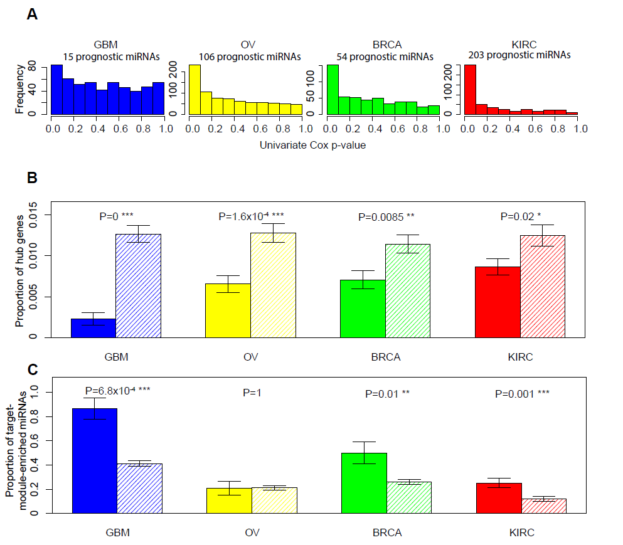
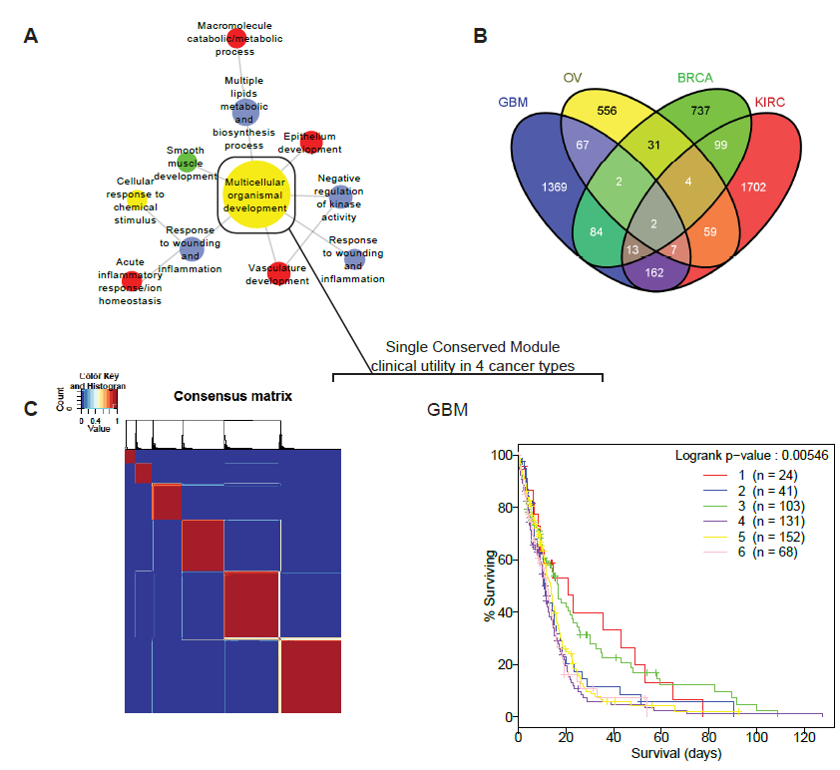
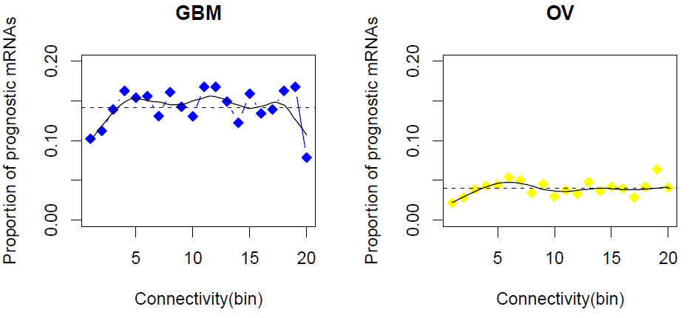
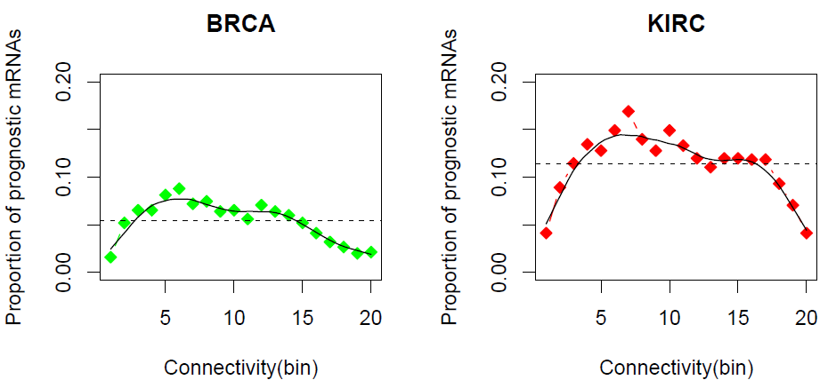
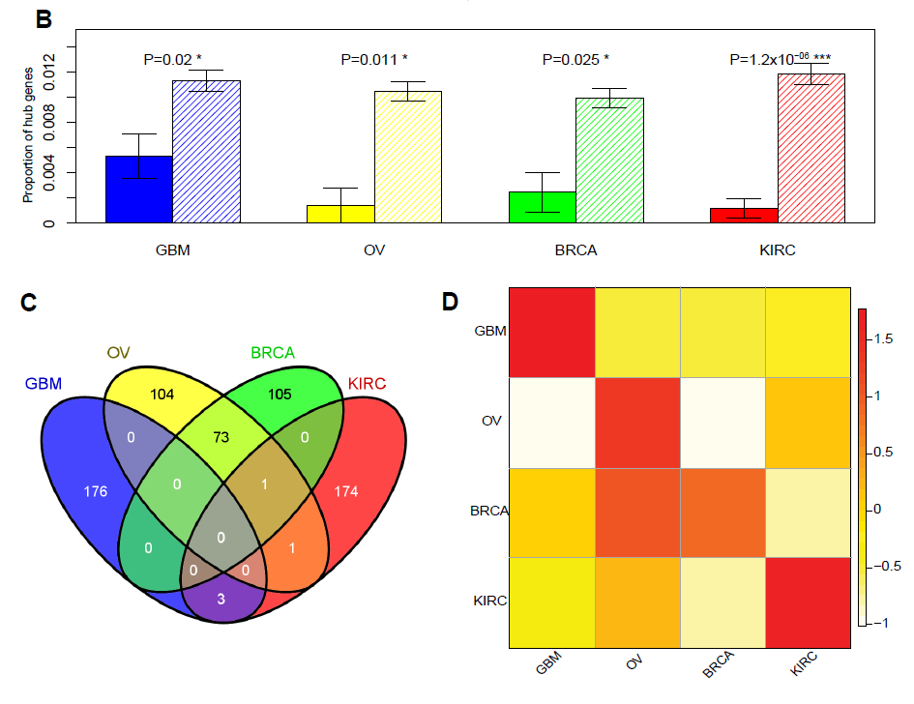
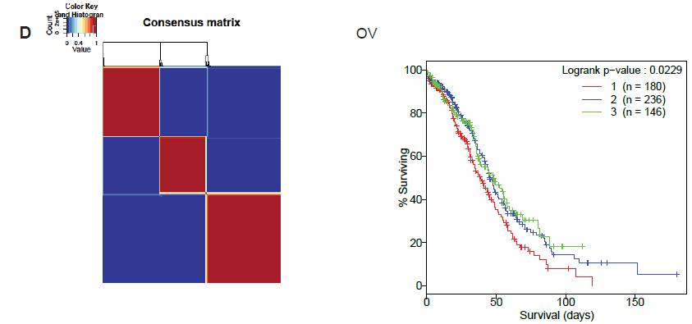
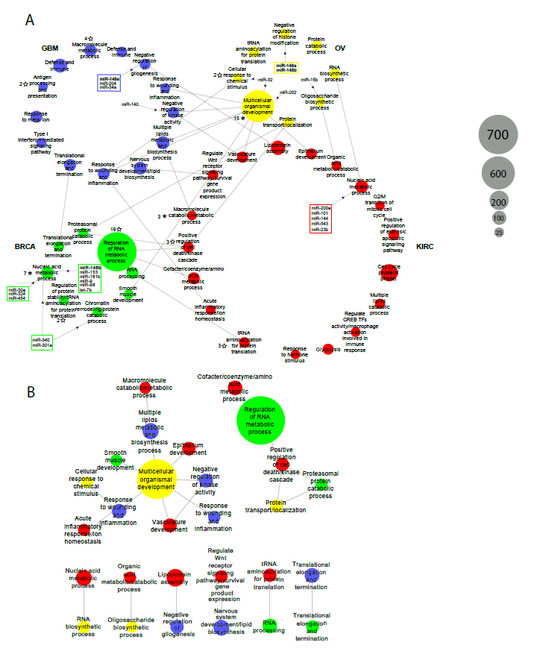
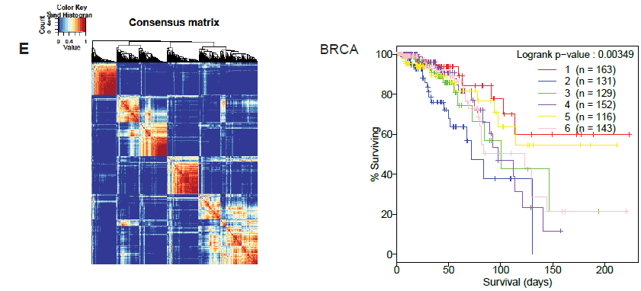
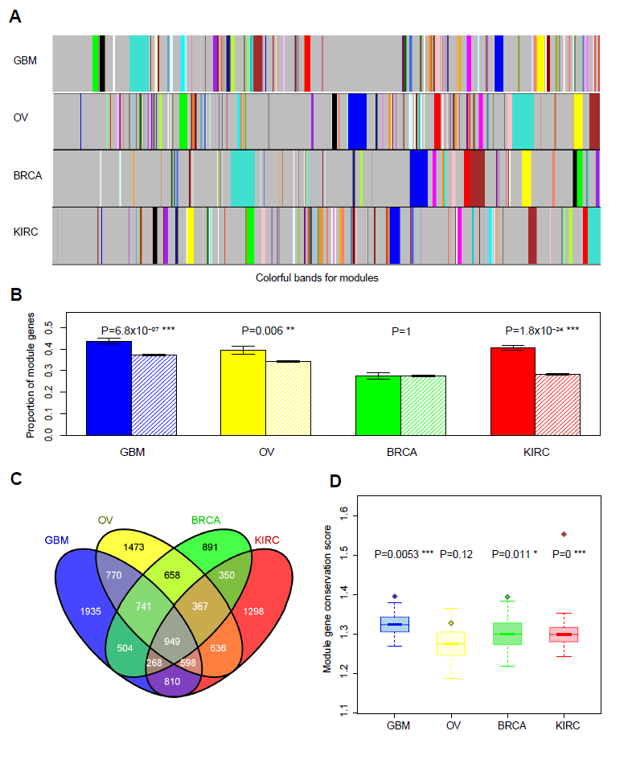
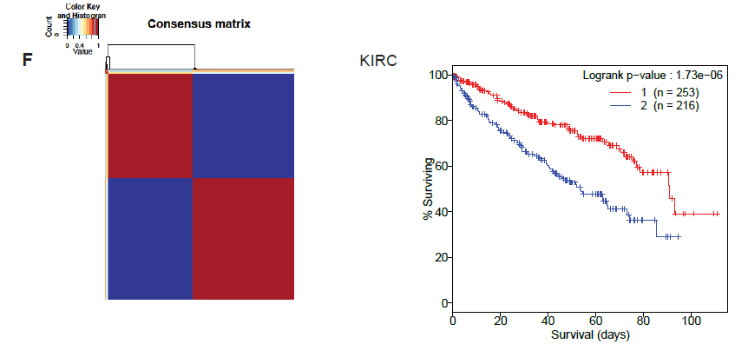
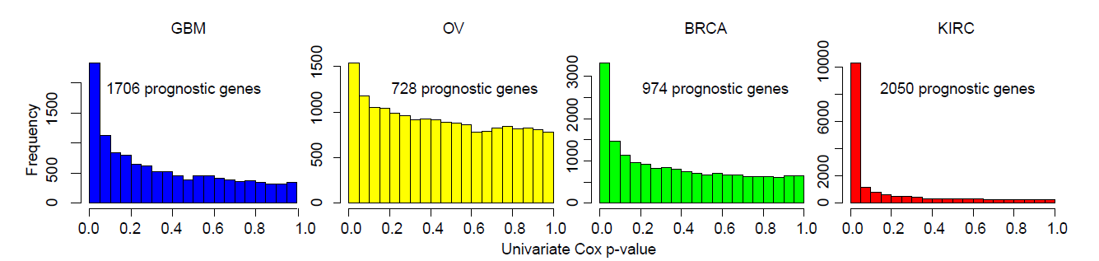
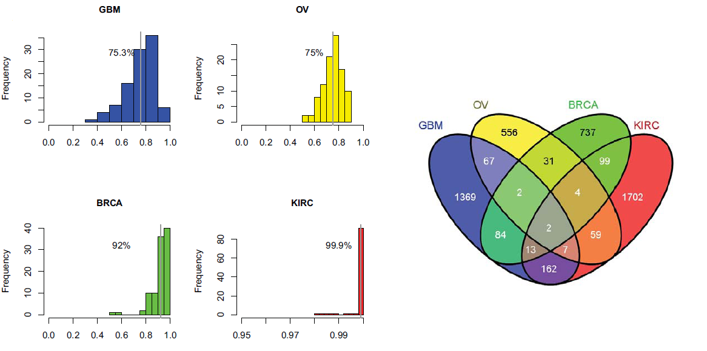
Gene co-expression network analysis reveals common system-level properties of prognostic genes across cancer types
Yang Yang^{1,2}, Leng Han¹, Yuan Yuan^{1,3}, Jun Li¹, Nainan Hei¹, Han Liang^{1,3}*
¹Department of Bioinformatics and Computational Biology, The University of Texas MD Anderson Cancer Center, 1400 Pressler Street, Houston, TX 77030, USA
²Division of Biostatistics, The University of Texas Health Science Center at Houston School of Public Health, Houston TX 77030, USA
³Graduate Program in Structural & Computational Biology & Molecular Biophysics, Baylor College of Medicine, Houston, TX 77030, USA
Abstract
Prognostic mRNA higher in connectivity but depleted in hubs
Target genes of prognostic miRNA genes show same patterns
Clinical utility of prognostic module signature
Prognostic genes are key molecules informative for cancer prognosis and treatment. Previous studies have focused on the properties of individual prognostic genes, but have lacked a global view of their higher-level properties in biological systems. Using genomic data from The Cancer Genome Atlas, we examined the properties of prognostic genes in gene co-expression networks for four cancer types. We found that prognostic mRNA genes tend not to be hub genes, and this pattern is unique to the corresponding cancer-type specific network. In contrast, the prognostic genes are enriched in module genes, especially in module genes conserved across different cancer co-expression networks. Furthermore, the target genes of prognostic miRNA genes show similar patterns. We identified the modules enriched in various prognostic genes, some of which show cross-tumor conservation. Our study presents a critical view of the emergent properties of prognostic genes in biological networks, providing deep insights into their behavior as “informers.”
A
A
Summary of TCGA genomic datasets used in this study
Cancer type | Co-expression network construction | Identification of prognostic mRNAs* | Identification of prognostic miRNAs*
GBM | Agilent 244K microarray >500 samples | Agilent 244K microarray >500 samples | Agilent 8×15K miRNA microarray >480 samples
OV | Agilent 244K microarray >560 samples | Agilent 244K microarray >560 samples | Agilent 8×15K miRNA microarray >560 samples
BRCA | Agilent 244K microarray >520 samples | Illumina HiSeq RNA-Seq >830 samples | Illumina RNA-Seq >830 samples
KIRC | Agilent 244K microarray >70 samples | Illumina HiSeq RNA-Seq >460 samples | Illumina RNA-Seq >480 samples
Target genes of prognostic miRNA genes show same patterns. (A) Prognostic miRNA genes were identified by FDR according to signal-to-noise ratio. (B) Target genes of prognostic miRNA genes (in solid bar) are depleted in hubs for all four cancers. (C) Target genes of prognostic miRNAs (in solid bar) are enriched in the modules, except for OV, which shows no pattern.
Prognostic mRNA higher in connectivity but depleted in hubs. (A) Higher connectivity of prognostic genes was observed in each of the 4 cancers as well as an obvious depletion trend in extremely connected hubs. (B) Prognostic genes (in solid bar) are significantly depleted in hubs for all 4 cancers. (C) Hubs from each cancer show very rare intersection, except between OV and BRCA due to high tissue homogeneity. (D) Cancer-label-permutated test demonstrated a prognostic gene’s hub depletion is observed only in its own cancer type (diagonal red) in the heatmap format presentation.
Integrative analysis of prognostic modules across cancer types
A
Prognostic mRNA enriched in network modules
*When mRNA gene or miRNA expression data were available from more than one platform, we chose the one with a better signal-to-noise ratio.
Prognostic mRNA genes defined in 4 cancers
A
B
Clinical utility of prognostic module signature. (A) Most conserved OV “multicellular organismal development” module with 610 genes connected to 10 other prognostic modules across all 4 cancer types. (B) Overall share of prognostic genes across 4 cancer types is small. (C)-(F) NMF clustering based on the OV module: 610 genes identified patient subgroups with significantly different survival probability, not only in OV but also in 3 other cancers.
C
Contact
Han Liang
hliang1@mdanderson.org; Tel: 1-713-745-9815
http://odin.mdacc.tmc.edu/~hliang1/
Postdoc/graduate student positions are available
Prognostic mRNA enriched in network modules. (A) Weighted gene co-expression network algorithm identified different sized modules. Fixed colors are used to represent the biggest, 2nd biggest modules and so on. (B) Prognostic genes (in solid bar) are enriched in modules. (C) Module genes show large overlap across 4 cancer types. (D) Boxplot showing that prognostic genes tend to be more conserved than module genes. Y-axis represents the module-gene observation score, which ranges from 0 to 4, with 0 indicating no module gene in any of the four cancer types and 4 indicating a module gene in all four cancer types. Each boxplot represents the conservation-score distribution of all the genes in the network; the diamond dot represents the mean conservation score of prognostic genes.
Integrative analysis of prognostic modules across cancer types. (A) The 47 prognostic modules are plotted in 4 circles, each representing one cancer type. Major GO terms were annotated to each module. Grey solid lines represent the conservation correspondence between two modules from two different cancer types. Dashed grey lines with black arrow represent the connections of prognostic miRNAs whose target genes are enriched in the module. Two or more miRNAs targeting the same module(s) are enclosed within a rectangle; miRNAs as module regulators in more than one cancer type are shown in boldface. Solid black stars mark the modules enriched with significantly mutated pancancer genes, and the associated number indicates the number of mutated genes; unfilled black stars mark enrichment that is significant only before multiple testing correction. (B) Plot showing a zoomed-in view of the 22 modules with cross-tumor conservation correspondence in (A).
Acknowledgments
Prognostic genes defined in 4 cancers. (A) Different numbers of prognostic genes defined by FDR according to signal-to-noise ratio. (B) ¾ subset sampling of original samples demonstrated robustness of defined prognostic genes. (C) Prognostic genes show only small intersections among 4 cancer types.
This study was supported by NIH grants CA143883 and CA016672, Uterine SPORE Career Development Award to H.L.; UTMDACC – G.S. Hogan Gastrointestinal Research Fund, and the Lorraine Dell Program in Bioinformatics for Personalization of Cancer Medicine to H.L. We thank The Cancer Genome Atlas (TCGA) Research Network and TCGA PanCancer Analysis Working Group.

